Slide 1


SP3176 The Universe Chapter 6: Space and Time
Lim Zhi Han
Gerald Kang
Koh Zhi Yong

Slide 2
Learning Objectives
Understand what special relativity discusses.
Appreciate why the invariance of the speed of light necessitates special relativity.
Conceptualise space and time in the framework of special relativity and spacetime diagrams.
Mathematically analyse two bizarre phenomena arising from special relativity: time dilation and length contraction.
Apply Lorentz transformations to compare relative measurements.

Slide 3




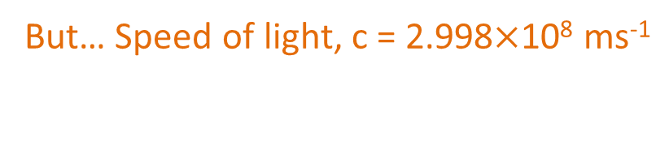
An interplanetary murder?
Suppose there are Martians.
On a beautiful afternoon, Dr U emerged from the shore of a tropical (Earth) island in his wetsuit and dive gear. Something streaked across the sky and Dr U fell. It was 4:15 pm. Upon investigation, it was found that exactly 3 minutes before Dr U fell, a weapon capable of interplanetary murder was fired in Mars. Mars was 60 million km away from Earth at the time of murder.
Did the Martian kill Dr U?
Speed of “bullet”: 60$×$10⁹ m/(3$×$60 s) = 3.33$×$10⁸ ms⁻¹
But… Speed of light, c = 2.998$×$10⁸ ms⁻¹

Slide 4

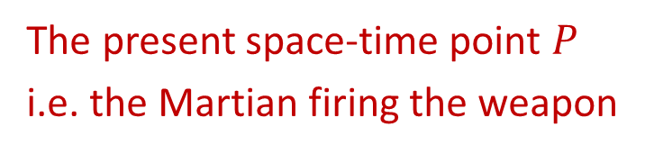
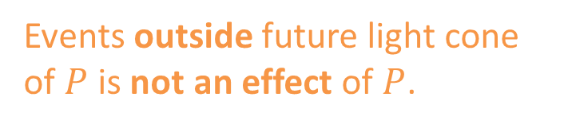


Cause and effect
Where is Dr U?
time
Future light cone of $P$
Events outside future light cone of $P$ is not an effect of $P$.
space
The present space-time point $P$
i.e. the Martian firing the weapon
Events outside past light cone of $P$ is not a cause of $P$
Past light cone of $P$

Slide 5
Throwing a tennis ball from different perspectives
What you see
What your friend sees

Slide 6
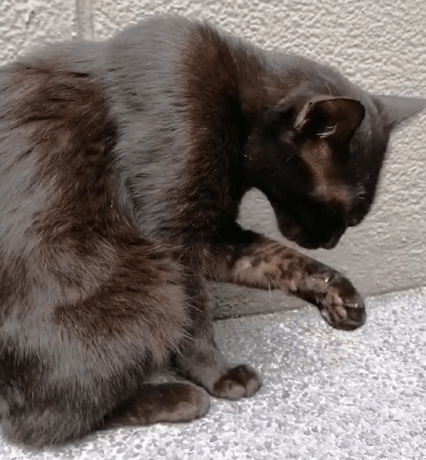

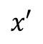

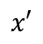
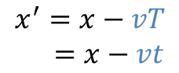
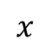
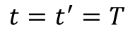
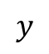
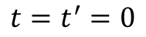
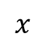
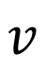
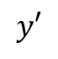

Galilean relativity (i.e. everyday life)
$$y′$$
$$v$$
Observer 1
$$x′$$
$$x′$$
$$x^{′}=x−vT \\ =x−vt$$
$$y$$
$$vt$$
$$t=t^{′}=0$$
Observer 2
$$t=t^{′}=T$$
$$x$$
$$x$$
Notes:
Draw in vt

Slide 7
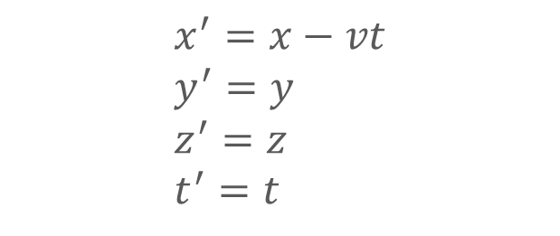
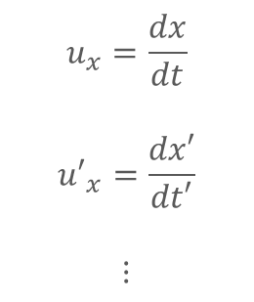
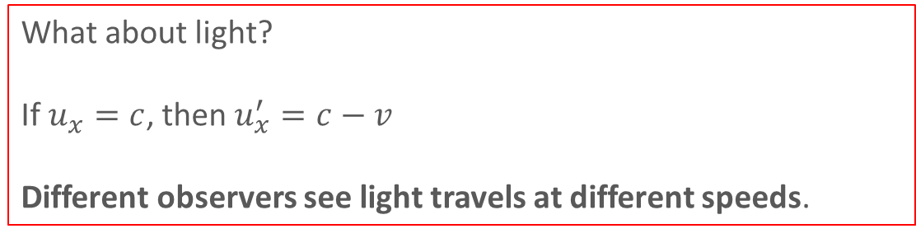
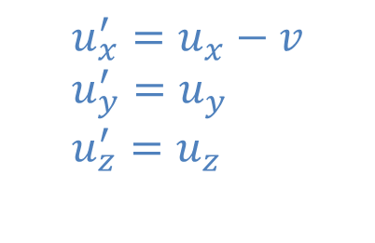
Galilean transformations
Position and time
Velocities
$$x^{′}=x−vt \\ y^{′}=y \\ z^{′}=z \\ t^{′}=t$$
Differentiate wrt time
$$u_{x}^{′}=u_{x}−v \\ u_{y}^{′}=u_{y} \\ u_{z}^{′}=u_{z}$$
$$u_{x}=\frac{dx}{dt}$$
$${u′}_{x}=\frac{dx′}{dt′}$$
$$⋮$$
What about light?
If $u_{x}=c$, then $u_{x}^{′}=c−v$
Different observers see light travels at different speeds.
Notes:
Write in u = dr/dt

Slide 8

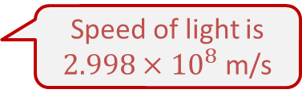
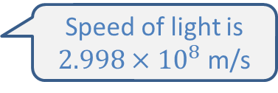
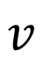
BUT.. Speed of light is the same for inertial observers
~
~
~
~
~
~
~
~
$$v$$
Speed of light is $2.998×{10}^{8}$ m/s
Observer 1
Predicted by theory.
Experimentally verified!
Observer 2
Speed of light is $2.998×{10}^{8}$ m/s

Slide 9
What is
Special Relativity
Looking at the special case of comparing inertial observers
Inertial = moving at constant speed, experiencing no acceleration
Physics is the same for all observers.
BUT observations are relative to observers
Aim: Relate the observations of one observer to the other

Slide 10

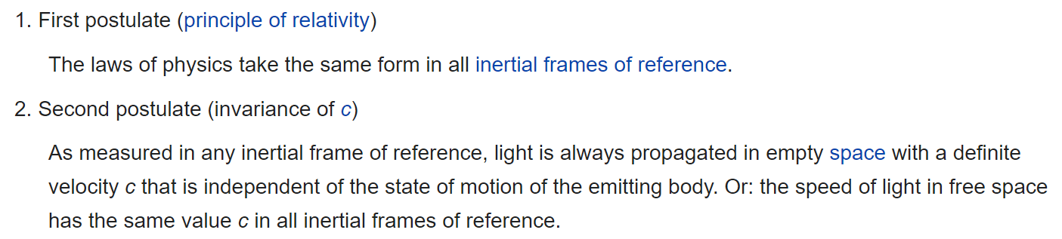

Slide 11
A thought experiment..
What you see
What your friend sees

Slide 12

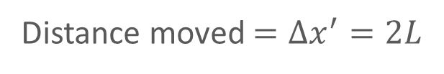
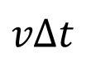

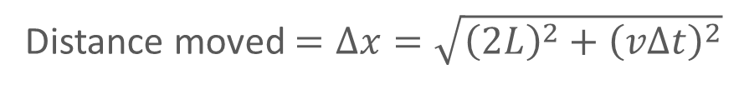
An informal derivation for time dilation
You see a stationary clock
Your friend sees a moving clock
Tock
L
Tick
L
Tock
Tick
$$vΔt$$
Photon’s motion in a tick-tock:
Distance moved $=Δx^{′}=2L$
Distance moved $=Δx=\sqrt{{\left(2L\right)}^{2}+{\left(vΔt\right)}^{2}}$
T$ime taken=Δt^{′}$
T$ime taken=Δt$

Slide 13
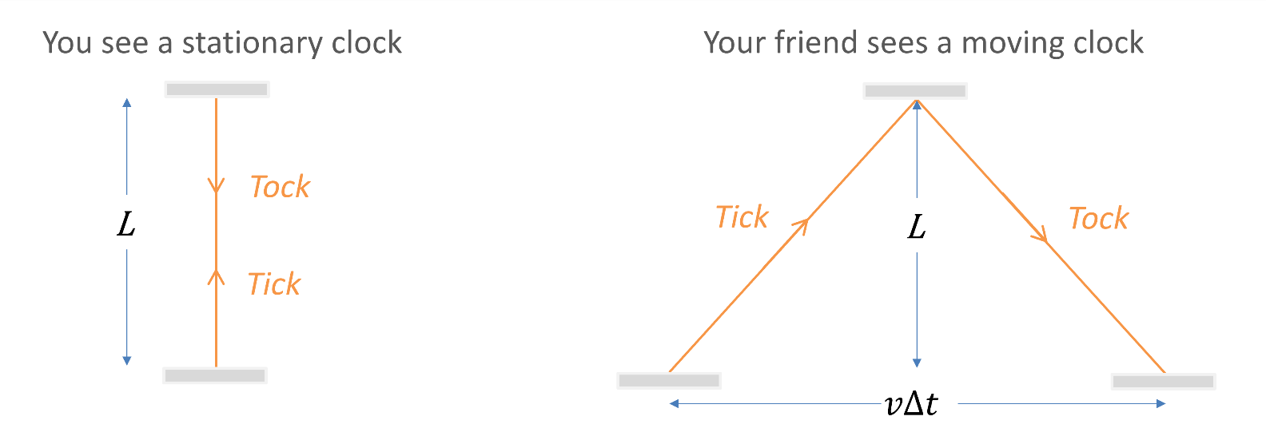
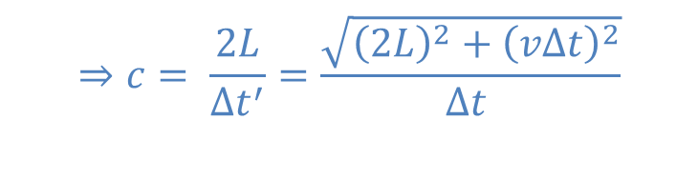

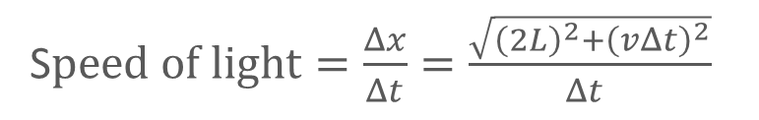
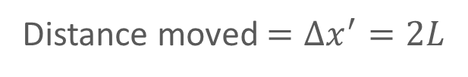
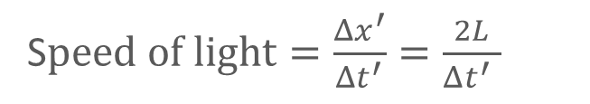


An informal derivation for time dilation
You see a stationary clock
Your friend sees a moving clock
Distance moved $=Δx^{′}=2L$
Distance moved $=Δx=\sqrt{{\left(2L\right)}^{2}+{\left(vΔt\right)}^{2}}$
T$ime taken=Δt^{′}$
T$ime taken=Δt$
S$peed of light=\frac{Δx^{′}}{Δt^{′}}=\frac{2L}{Δt^{′} }$
S$peed of light=\frac{Δx}{Δt}=\frac{\sqrt{{\left(2L\right)}^{2}+{\left(vΔt\right)}^{2}}}{Δt }$
$$⇒c= \frac{2L}{{Δt}^{′}}=\frac{\sqrt{{\left(2L\right)}^{2}+{\left(vΔt\right)}^{2}}}{Δt }$$
Postulate: Invariance of speed of light

Slide 14
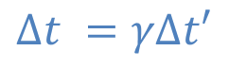

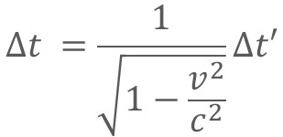
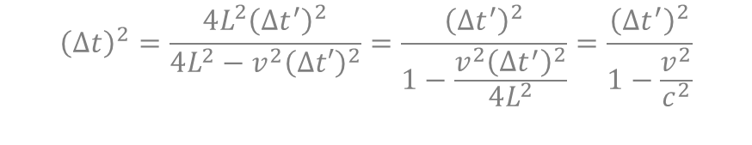
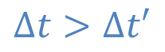
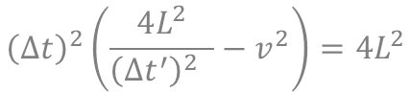
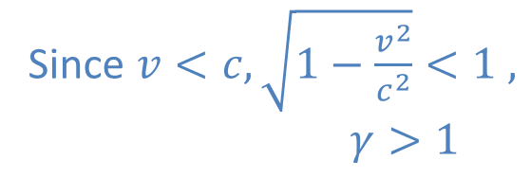
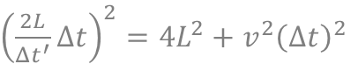
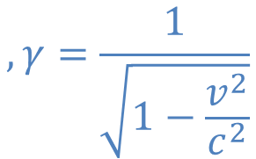
An informal derivation for time dilation
Invariance of s$peed of light$ $$⇒c= \frac{2L}{{Δt}^{′}}=\frac{\sqrt{{\left(2L\right)}^{2}+{\left(vΔt\right)}^{2}}}{Δt }$$
$$, γ=\frac{1}{\sqrt{1−\frac{v^{2}}{c^{2}}}}$$
$$Δt =γΔt′$$
${\left(\frac{2L}{Δt^{′}}Δt\right)}^{2}=4L^{2}+v^{2}{\left(Δt\right)}^{2}$
$${\left(Δt\right)}^{2}\left(\frac{4L^{2}}{{\left(Δt^{′}\right)}^{2} }−v^{2}\right)=4L^{2}$$
Since $v<c, \sqrt{1−\frac{v^{2}}{c^{2}}}<1 ,$
$γ>1$
$${\left(Δt\right)}^{2}=\frac{4L^{2}{\left(Δt^{′}\right)}^{2}}{4L^{2}−v^{2}{\left(Δt′\right)}^{2}}=\frac{{\left(Δt^{′}\right)}^{2}}{1−\frac{v^{2}{\left(Δt^{′}\right)}^{2}}{4L^{2}}}=\frac{{\left(Δt^{′}\right)}^{2}}{1−\frac{v^{2}}{c^{2}}}$$
$$Δt =\frac{1}{\sqrt{1−\frac{v^{2}}{c^{2}}}}Δt′$$
$$Δt>Δt′$$

Slide 15

Summary of time dilation
Moving observer
Stationary observer
What you see
What your friend sees
$$Δt^{′}<Δt$$
Stationary observer measures a longer time interval between the events.
If stationary observer could visually see a moving analogue clock face, the hands move in slow motion.

Slide 16
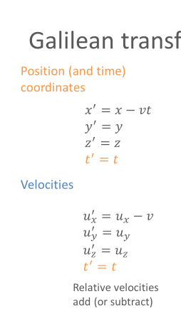
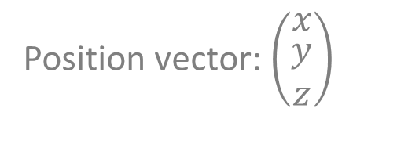
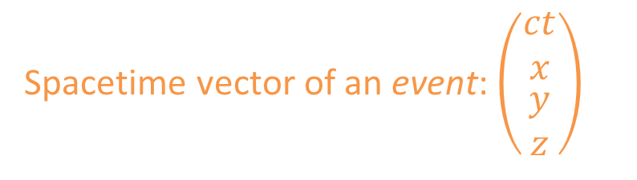

Henceforth, space by itself, and time by itself, are doomed to fade away into mere shadows, and only a kind of union of the two will preserve an independent reality.
– Hermann Minkowski
Time: $t$
Spacetime vector of an event: $\left(\begin{matrix}\begin{aligned}ct \\ x\end{aligned} \\ \begin{aligned}y \\ z\end{aligned}\end{matrix}\right)$
Not the correct picture
Position vector: $\left(\begin{matrix}x \\ \begin{aligned}y \\ z\end{aligned}\end{matrix}\right)$

Slide 17
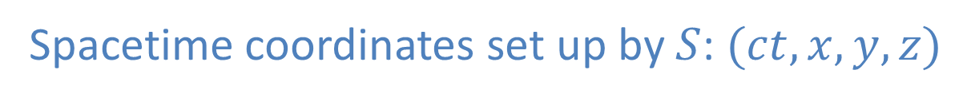
Spacetime observers
Two observers $S$ and $S′$. One wear earring. The other don’t.
Spacetime coordinates set up by $S$: $(ct,x,y,z)$
Spacetime coordinates set up by $S′$: $(ct^{′},x^{′},y^{′},z′)$
Image credit: Dbachman, CC-BY-SA-3.0

Slide 18

Spacetime observers in relative motion
Two observers $S$ and $S′$ are in inertial frames (no forces acting on them).
Let their constant relative velocity be $v$ in the $x$-direction.
Spacetime coordinates set up by $S$: $(ct,x,y,z)$
Spacetime coordinates set up by $S′$: $(ct^{′},x^{′},y^{′},z′)$
What is the relationship between $\left(ct,x,y,z\right)$ and $(ct^{′},x^{′},y^{′},z′)$?

Slide 19

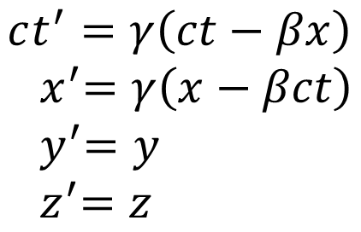
Spacetime observers in relative motion
Relationship between $\left(ct,x,y,z\right)$ and $(ct^{′},x^{′},y^{′},z′)$:
$$ct^{′}=γ\left(ct−βx\right) \\ { x}^{′}=γ\left(x−βct\right) \\ { y}^{′}=y \\ { z}^{′}=z$$
Lorentz Transformation
where $γ=\frac{1}{\sqrt{1−β^{2}}} , β=\frac{v}{c}$
Activity 1:
If the relative velocity between the observers is low, i.e $v≪c$, what do the LT become?

Slide 20
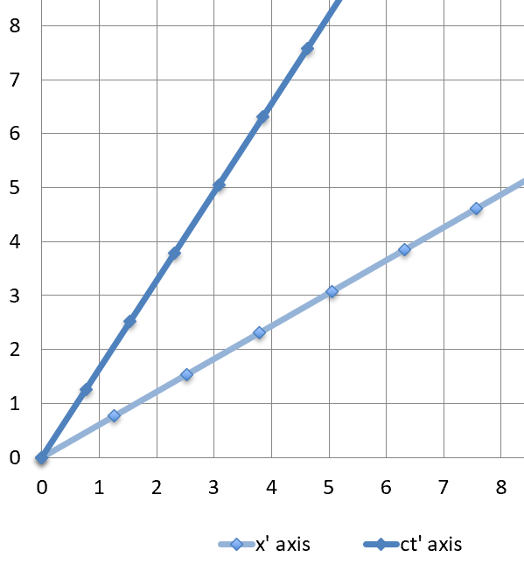
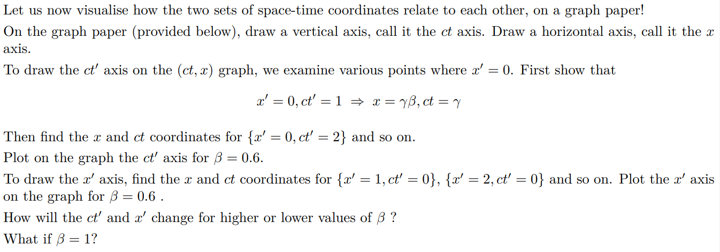
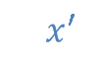



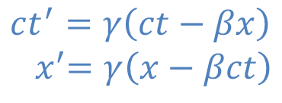

Space-time diagram: Visualising the Lorentz Transformation
$$ct^{′}=γ\left(ct−βx\right) \\ { x}^{′}=γ\left(x−βct\right)$$
where $γ=\frac{1}{\sqrt{1−β^{2}}} , β=\frac{v}{c}$
Lorentz Transformation
$$ct$$
$$ct^{′}$$
Activity during IS
$${ x}^{′}$$
$$x$$

Slide 21
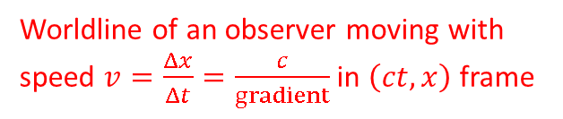
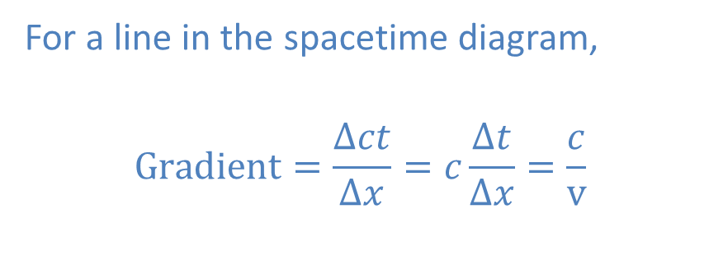

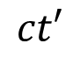



Reading spacetime diagrams
For a line in the spacetime diagram,
$$Gradient=\frac{Δct}{Δx}=c\frac{Δt}{Δx}=\frac{c}{v}$$
$$ct$$
$$ct′$$
Worldline of an observer moving with speed $v=\frac{Δx}{Δt}=\frac{c}{gradient}$ in $\left(ct,x\right)$ frame
Also worldline of stationary observer in $\left(ct′,x′\right)$ frame
Worldline of a stationary observer in $\left(ct,x\right)$ frame
$$x′$$
$$x$$
Notes:
X = 0 line

Slide 22




The Light line
$$ct$$
$$ct=x$$
Light line
$$Gradient=\frac{Δct}{Δx}=1$$
$$x$$

Slide 23





Spacetime Interval – the new “distance”
Generalising to 3D:
and lazy to write ()
$$dl=\sqrt{{\left(dx\right)}^{2}+{\left(dy\right)}^{2}}$$
$$dy$$
$$dx$$
$$dl^{2}=dx^{2}+dy^{2}+dz^{2}$$
Define the spacetime interval $ds$:
$$ds^{2}=−c^{2}dt^{2}+dx^{2}+dy^{2}+dz^{2}$$
$ds$ is the “distance” between 2 events $\left(ct,x,y,z\right)$and $(ct+cdt,x+dx,y+dy,z+dz)$

Slide 24



Spacetime Interval and Light
$$ct$$
$$ct=x$$
What is the spacetime interval between any 2 points on the light line?
Light line
$$x$$
$$ds^{2}=−d{(ct)}^{2}+dx^{2}$$
$$=−d{(ct)}^{2}+d{\left(ct\right)}^{2} \\ =0$$
Light: $ds^{2}=0$

Slide 25











Invariance
Same-same for different observers
Example: Length is invariant under a rotation transformation.
$$dl^{2}=dx^{2}+dy^{2} \\ ={\left(5−1\right)}^{2}+{\left(1−4\right)}^{2} \\ =25$$
$$d{l′}^{2}=d{x′}^{2}+d{y′}^{2} \\ ={\left(5.009−1.765\right)}^{2}+{\left(0−3.726\right)}^{2} \\ =25$$
$$(1.765, 3.726)$$
$$(1,4)$$
$$(5, 1)$$
$$(5.099, 0)$$
Generally,
$$x^{′}=x\cos{θ+y\sin{θ}}$$
$$θ$$
$$θ=\tan^{−1}{\frac{1}{5}}$$
$$y^{′}=−x\sin{θ+y\cos{θ}}$$
$$d{l′}^{2}=d{x′}^{2}+d{y′}^{2} \\ ={\left(dx\cos{θ+dy\sin{θ}}\right)}^{2}+{\left(−dx\sin{θ+dy\cos{θ}}\right)}^{2} \\ =dx^{2}\left(\cos^{2}{θ}+\sin^{2}{θ}\right)+2dxdy\left(\cos{θ}\sin{θ}−\cos{θ}\sin{θ}\right)+dy^{2}\left(\sin^{2}{θ}+\cos^{2}{θ}\right) \\ =dx^{2}+dy^{2}=dl^{2}$$
Notes:
Will skip the math

Slide 26


Invariance of the Spacetime Interval
$$ct^{′}=γ\left(ct−βx\right) \\ { x}^{′}=γ\left(x−βct\right) \\ { y}^{′}=y \\ { z}^{′}=z$$
$$ds^{2}=−c^{2}dt^{2}+dx^{2}+dy^{2}+dz^{2}$$
Lorentz Transformation
$$d{s′}^{2}=−c^{2}d{t′}^{2}+d{x′}^{2}+d{y′}^{2}+d{z′}^{2}$$
Activity during IS
Show that $d{s′}^{2}=ds^{2}$
The spacetime interval is invariant under a Lorentz transformation.

Slide 27






Invariance of Spacetime Interval
$⇒$ Invariance of the Speed of Light
Invariance of Spacetime Interval:
$$ds^{2}=−c^{2}dt^{2}+dx^{2}=d{s′}^{2}=−c^{2}d{t′}^{2}+d{x′}^{2}$$
If $ds^{2}=0$, then $d{s′}^{2}=0$
$$⇒$$
$$⇒$$
Particle moves at speed $c$
Particle moves at speed $c$
Since the spacetime interval is invariant under Lorentz transformation,
The speed of light is an invariant under Lorentz transformation.

Slide 28



Things happening at the same time for $S′$ do not happen at the same time for $S$
Activity 4
Event A
Event B
$S′$ : Event A and B happen at the same time (at $ct^{′}=0$)
$S$ : Event A happens first.
Event B happens 3s later!
Relativity of simultaneity

Slide 29









$$ct$$
$S$and $S′$disagree with the time between 2 events
$$ct′$$
$$x′$$
Event 1
Event 2
$S′$ : Time between events is 1 unit
$S$ : Time between events is 1 unit.
$$x$$
$$Δt′<Δt$$
Time dilation

Slide 30





$$ct$$
$O$and $O′$disagree with the distance between 2 points
$$ct′$$
$$x′$$
World lines
Length as measured by $O$
Back of rod
Front of rod
Length as measured by $O′$
Observers measure length by looking at front and back of rod at the same time.
$$x$$
Length as measured by $O^{′}=1$ unit
Length contraction
Length as measured by $O 1$ unit

